Slide 1

Alzheimer’s Prediction

Slide 2
Team 8
Project Guide: Prof. Dr. Boyce Leann
Thanishma Bollineni (ADTA) | Sri Ramya Katukuri (DS) | Yogesh Meka (DS)
Modelling EDA Presentation | Preprocessing Prediction Presentation | Preprocessing Visualization Presentation

Slide 3
Problem Statement
With the aging of Populations across the world, there has never been a better time to understand the factors affecting cognitive health. This survey-based dataset cover older adults in the area of cognitive health regarding factors such as memory issues, mental well-being, and the ability to perform daily activities. By analyzing the variations across demographic groups such as age, gender, and other characteristics the study looks to identify early signs of Alzheimer’s disease. The insights derived will support healthcare professionals in improving early detection, guide targeted interventions and inform public health strategies that promote healthy aging. Our data was published by the Behavioral Risk Factor Surveillance System (BRFSS), which is a comprehensive, nationwide survey conducted by the Centers for Disease Control and Prevention (CDC).

Slide 4
Business Understanding
The goal of cognitive progression in health is early detection of disorders in cognition before these disorders have adverse health consequences.
This helps in understanding who or which groups are at risk of developing conditions such as memory loss and finding ways to support them, thus reducing suffering from such conditions as dementia.
It improves the quality of healthcare and helps in formulating public health policies that deal with the many problems associated with aging.
It aids in decision-making on resource allocation, promotes awareness and concern, and improves the well-being of the elderly.
It also encourages practical steps toward decreasing the burden of cognitive decline to ensure better results for individuals and communities.

Slide 5
Data Understanding
The dataset “Alzheimer’s Disease and Healthy Ageing” contains 284,142 rows and 31 columns, which include year, location, mental health topics, demographic stratifications, and detailed questions about aging and mental health metrics.
Columns | Description
YearStart/YearEnd | Specifies the year of data collection
LocationDesc | Provides information about location where the data is collected from.
Question | Gives the context about the data collected
Data_Value | Responses to the questions asked in the survey.
Confidence_Limits | Lower and upper bounds of confidence limits while giving responses to questions in the form of data value.
Stratification | Classification of the individual for whom we have our response for. (Gender, Race/Ethinicity )

Slide 6
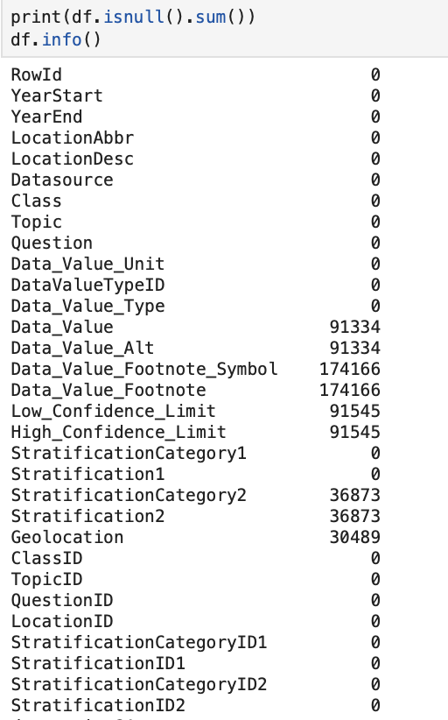
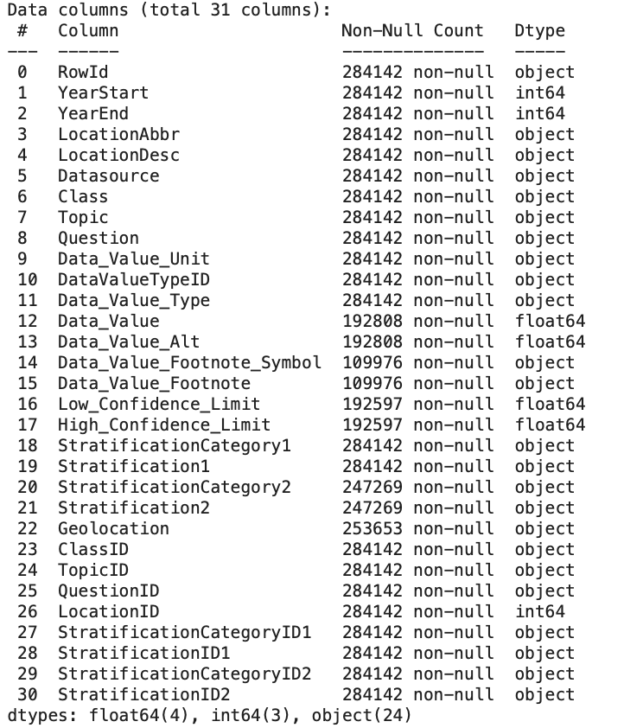
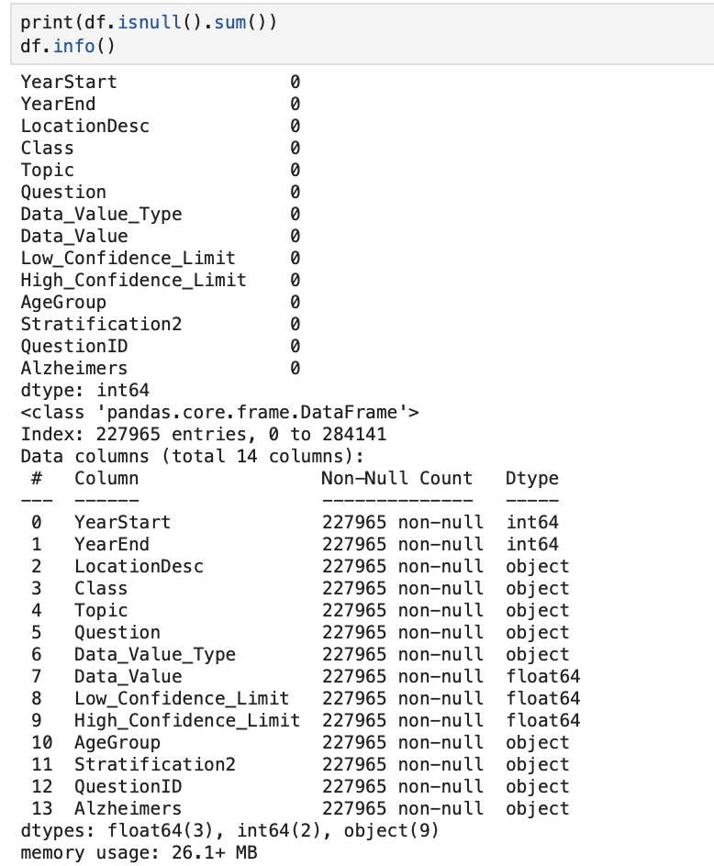
Before Preprocessing
After Preprocessing

Slide 7
Data Preprocessing
We cleaned ,the dataset of 284,412 rows using Python, the main tool used to ensure scalability and efficiency throughout the workflow
Irrelevant columns were removed to reduce the dataset to 16 columns and 227,965 rows.
All the duplicated records and blank entries were found and removed.
Missing values in the ‘confidence’ column were treated using mean imputation to retain data accuracy and analysed statistical properties of all columns using df.describe() to gain insights into the dataset.
Columns deemed irrelevant for EDA and modelling were removed
Misleading or unclear names were updated for clarity, such as renaming ‘Stratification1’ to ‘Age Group’
We majorly dropped columns that are not in order and duplicated columns as (Location : LocationDesc)

Slide 8
Synthetic Column Generation for Alzheimer's Analysis
Purpose of Synthetic Column:
Classify data into 'Yes' or 'No', based on the classification on the health topics, questions, data values, and their conditions.
Emphasize trends in health topics touching on Alzheimer's, lifestyle habits, and health screenings.
Estimate the chances of developing Alzheimer's disease and how our lifestyle, daily routine, and healthy aging would influence our cognitive health.

Slide 9
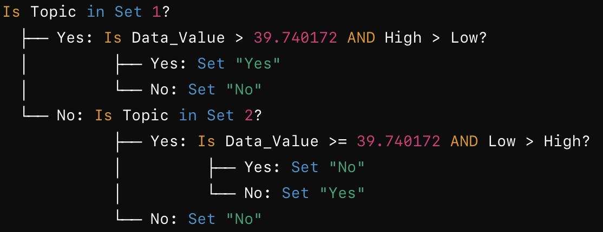
Logic for Creating Synthetic Column:
Set 1:
These are negative questions where the new synthetic column of likely to obtain alzheimer's would be yes (depending on the confidence bounds) if the answer for Data_Value is > Mean value, which is 39.74.
Set 2:
These are Positive questions where the new synthetic column of likely to obtain alzheimer's would be yes (depending on the confidence bounds), if the answer for Data_Value is < Mean value, which is 39.74.
High and low confidence limits depend on the boundaries of the confidence that express how confident or unconfident the person is to give a response to the inquiry with regard to the data value; high > low means they are confident, and low > high means vice-versa.

Slide 10
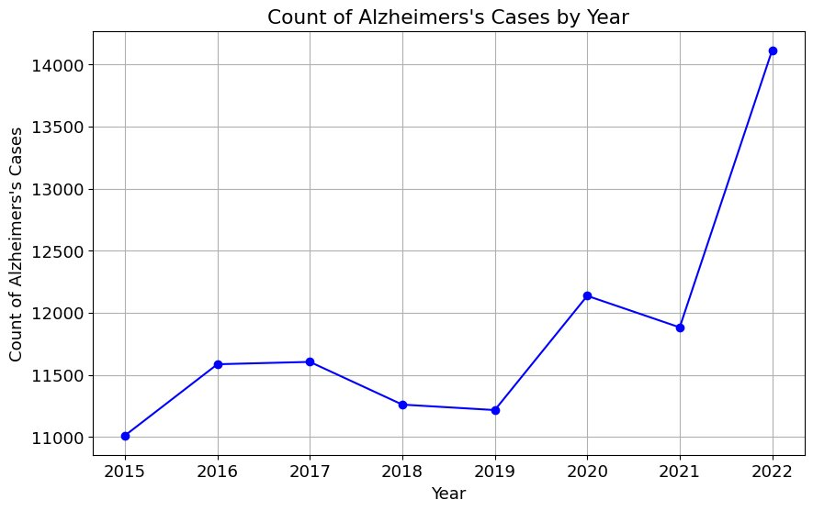
Exploratory Data Analysis (EDA) Trends and Distribution : Yearly Trends in Alzheimer’s Cases
Filtered the data on Alzheimer’s cases: filtered in ‘Alzheimer’s=Yes’, then grouped by YearEnd to count the occurrences.
Plotted a line chart to visualize how the cases of Alzheimer’s varies across years, including markers and gridlines for better readability.
Trend analysis gave a temporal view showing the possible growth or reduction of the cases over time.

Slide 11
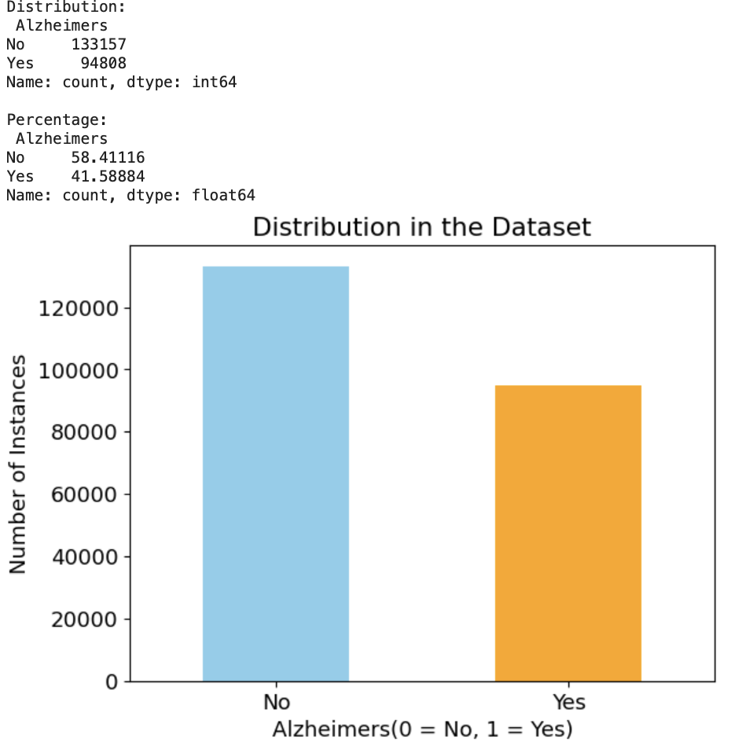
Bar Plot Visualization of Alzheimer’s
Distribution of the Alzheimer’s cases as 0=No and 1=Yes

Slide 12
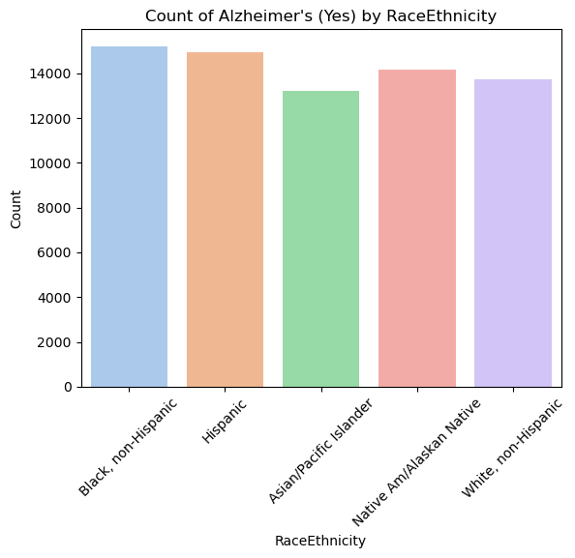
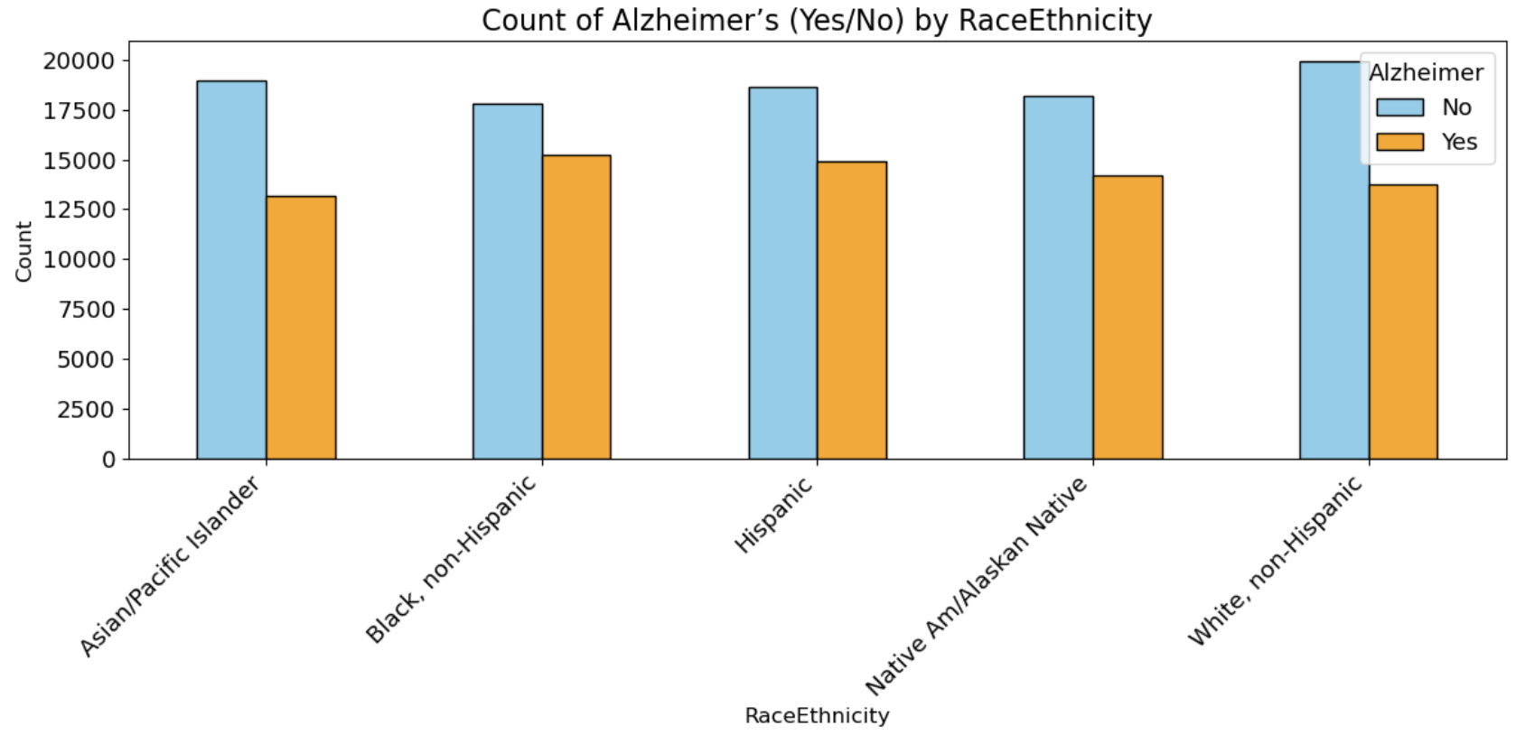
Analysis by Race/Ethnicity:
Used count plots to study how Alzheimer’s varies across racial and ethnic groups.
Developed grouped bar plots to analyze the distribution of Alzheimer’s cases across different racial and ethnic groups.
This visualization highlights disparities and prevalence patterns across different communities.

Slide 13
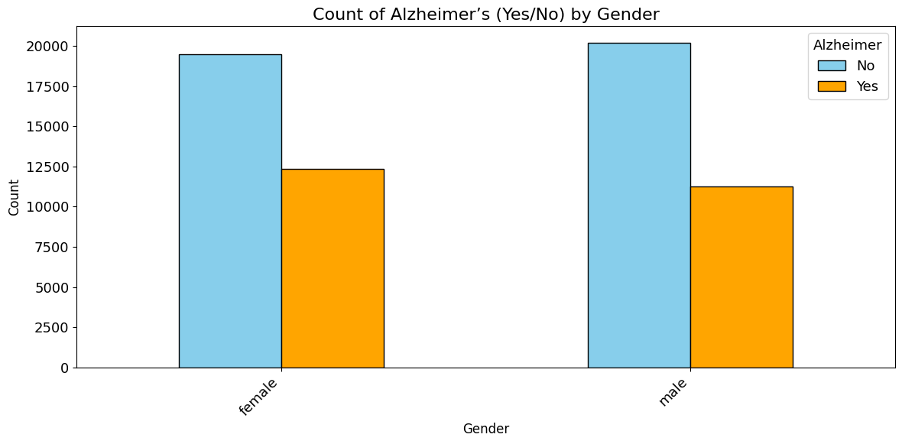
Focus on Alzheimer’s by Gender
Distribution of Alzheimer’s cases where the condition is “Yes” or “No”

Slide 14
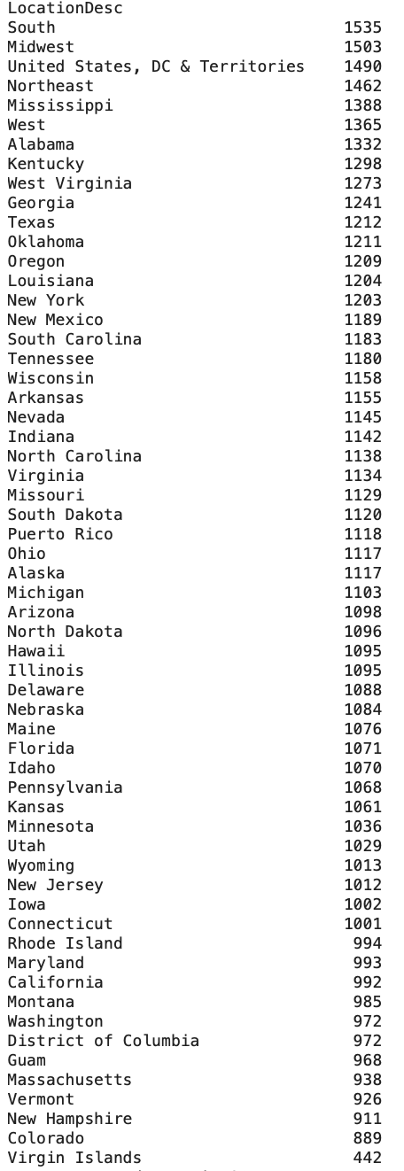
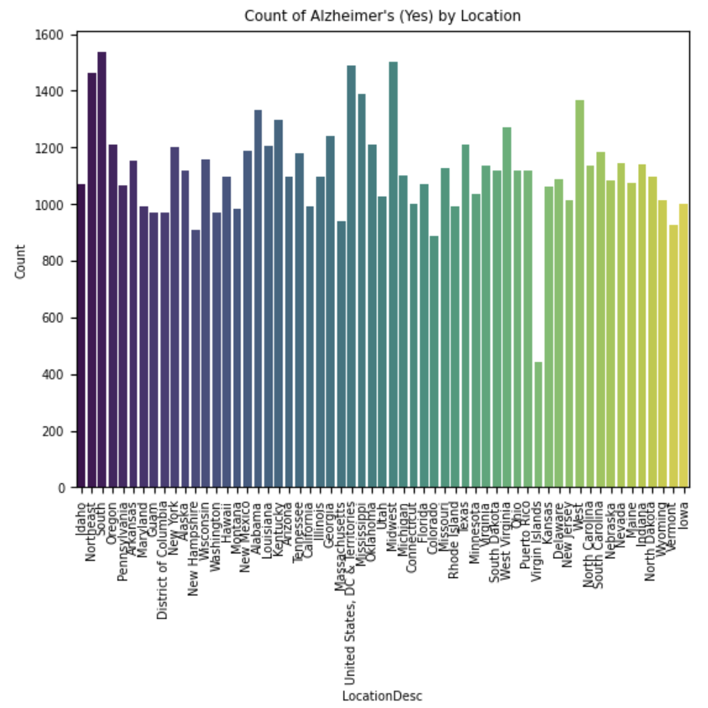

Slide 15
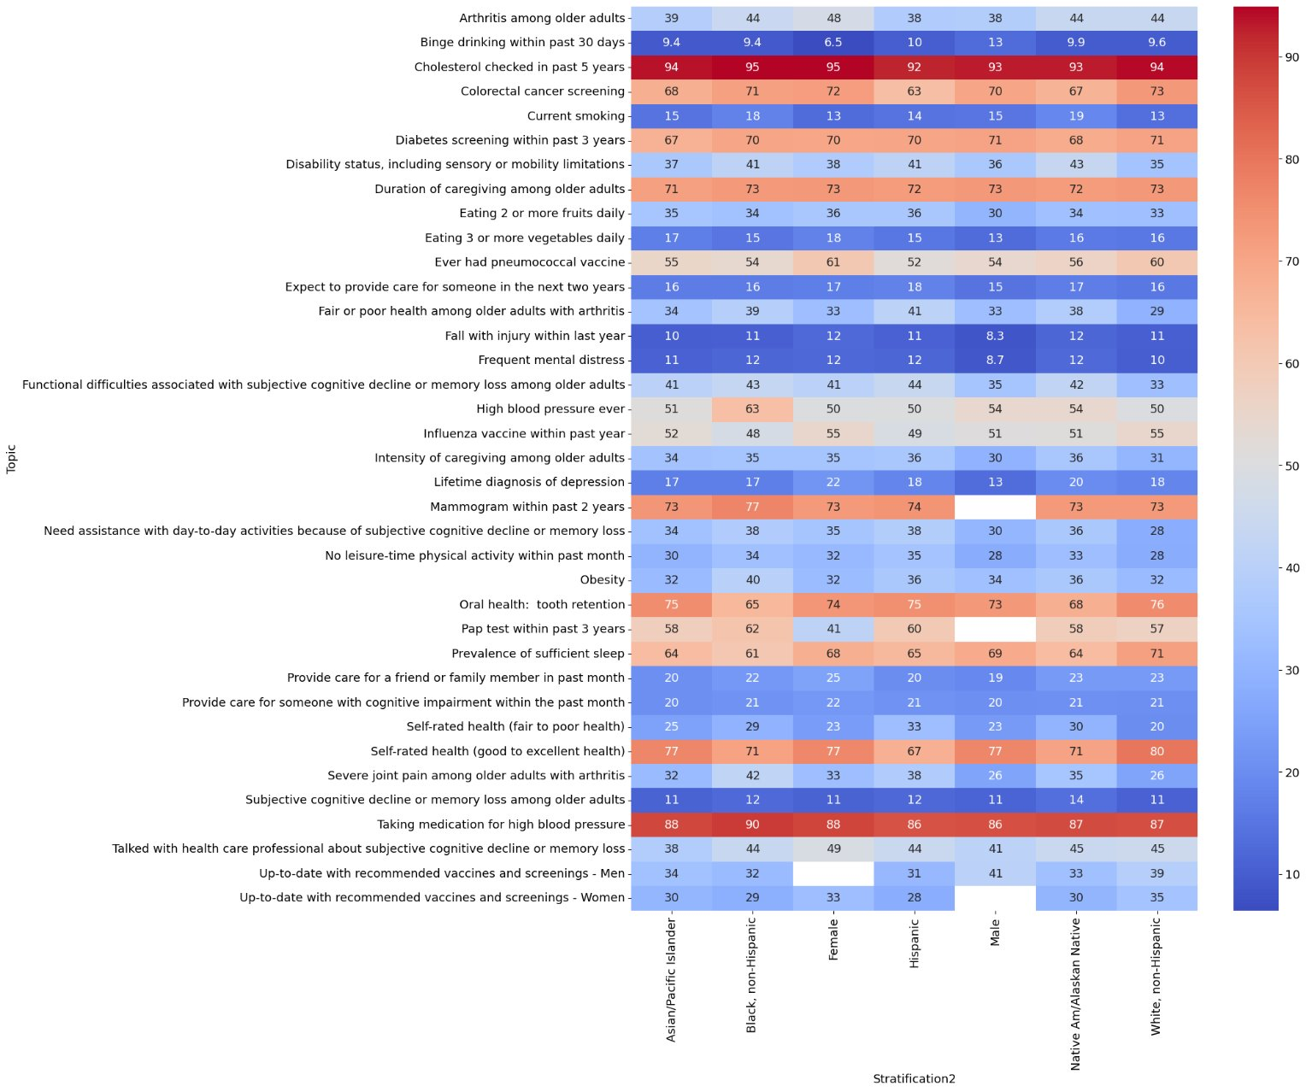
Topic-Wise Data Insights Using a Heatmap:​

Slide 16
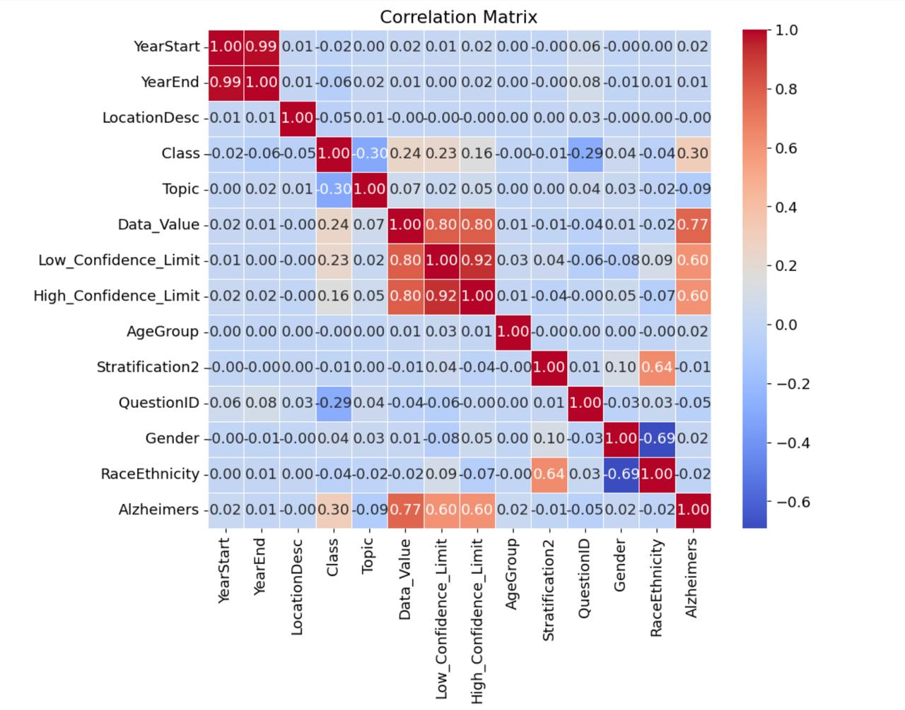
Correlation Matrix Calculation:

Slide 17
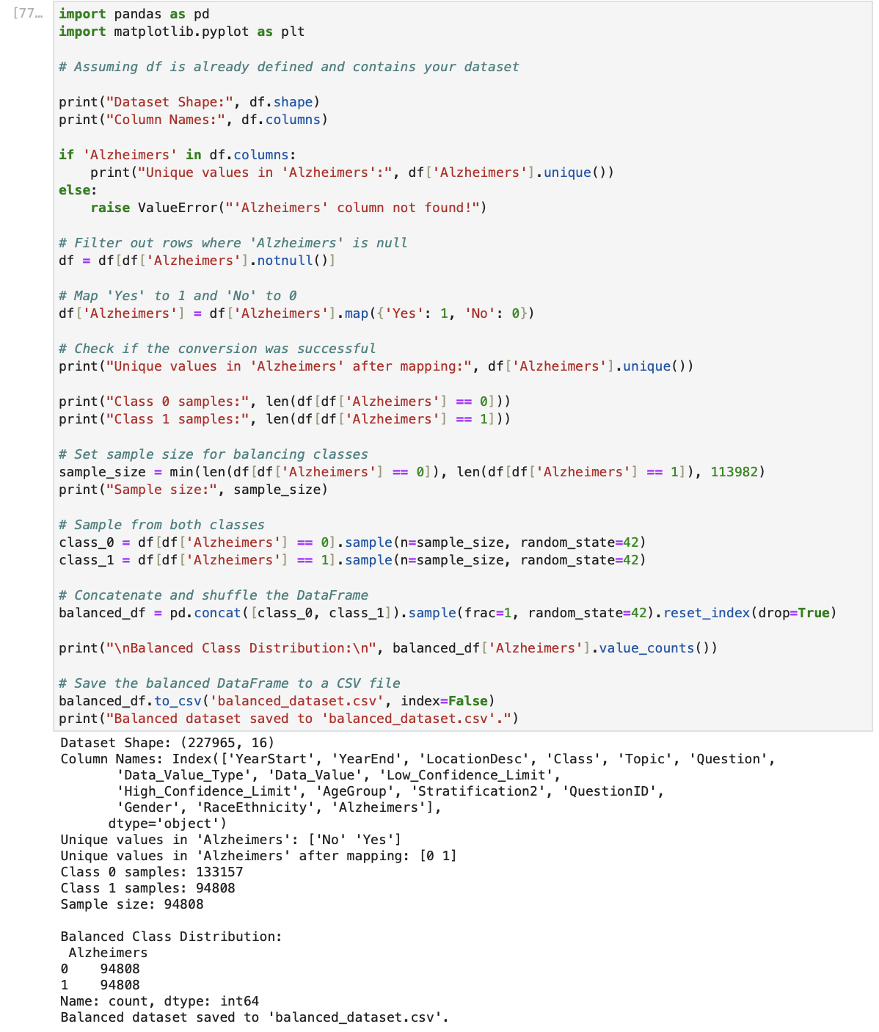

Slide 18
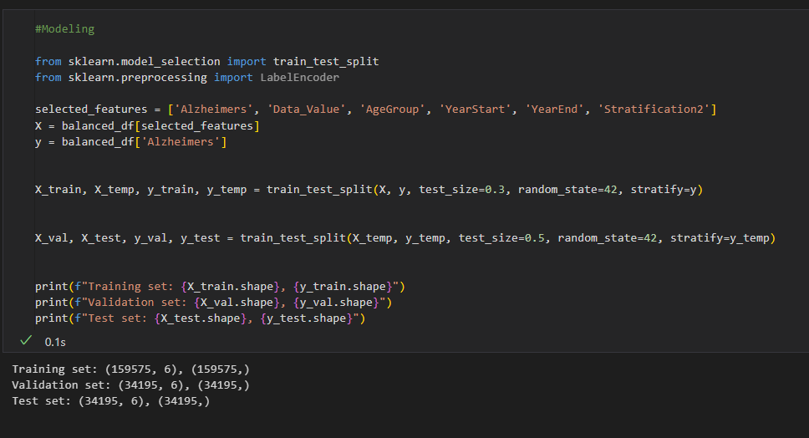
Modelling

Slide 19
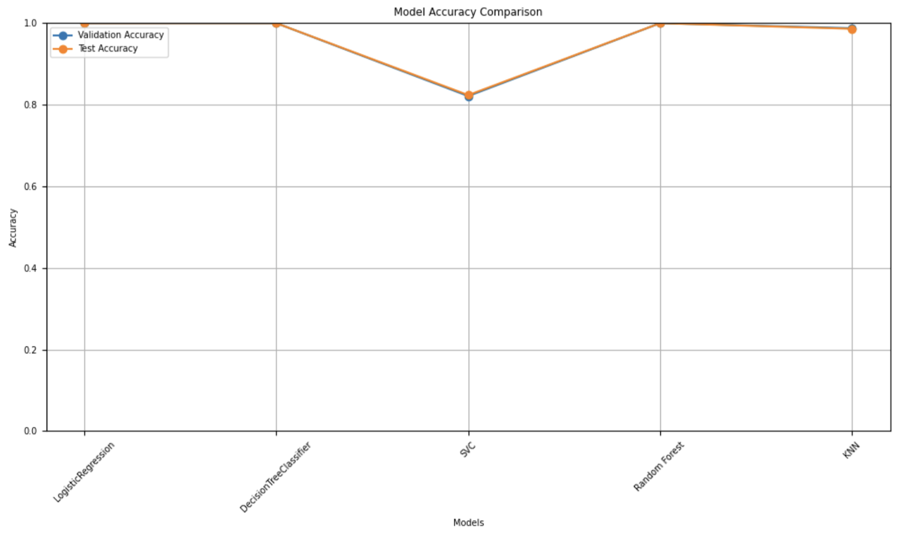
Model Accuracy Comparision

Slide 20
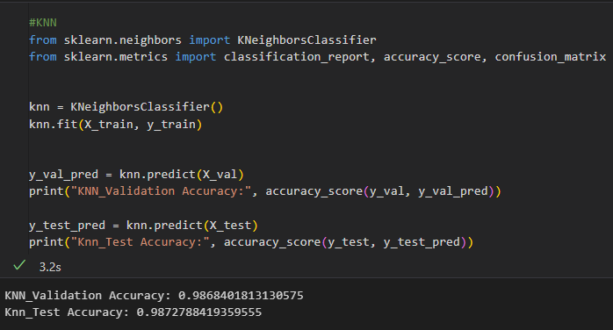
Model Evaluation and Selection
Model Evaluation:
Applied several machine learning algorithms: Random Forest, KNN, SVM and Logistic Regression
Feature selection and data imputation were performed to prepare the dataset for robust analysis.
Insights into Model Performance :
Some models showed signs of overfitting, making unreliable for unseen data.
KNN and Random Forest showed strong performance but overfitting and interpretability concerns came forward.
K-Nearest Neighbors(KNN):
Achieved 98.68% Validation accuracy and 98.72% test accuracy, indicating strong performance.
However, KNN may overfit easily in case of noisy data, affecting its reliability.

Slide 21
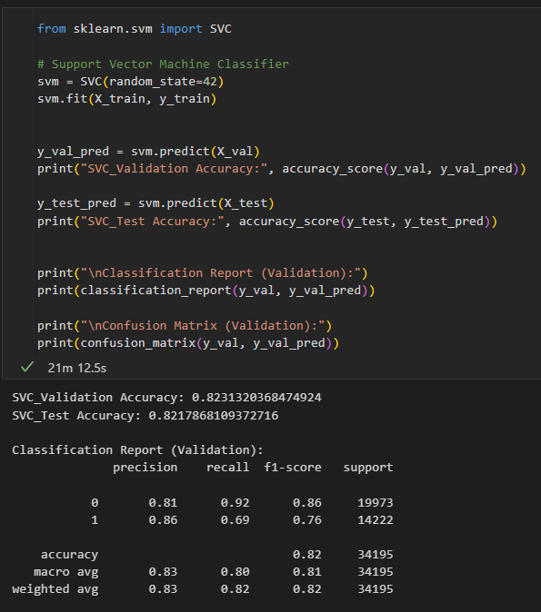
Model Selection: Why SVM?
Support Vector Machine (SVM):
The model shows consistency in results with a validation accuracy of 82.31%
Precision, recall and F1-scores of the model provide evidence that it generalizes well with no overfitting.
The usage of SVM is highly reliable in this case as the model is robust in handling high dimensional data and works great when the dataset size is low.
Why?
Because the other models overfitted or didn’t generalize well and hence cannot be very reliable on unseen data.
KNN and Random Forest did a great job but raised some flags on overfitting.
SVM was chosen since it balanced the trade-off between accuracy, generalization, and reliability.
This ability of the model to avoid overfitting and provide robust predictions across datasets made it the fittest for our problem.

Slide 22
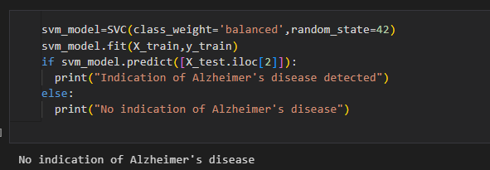
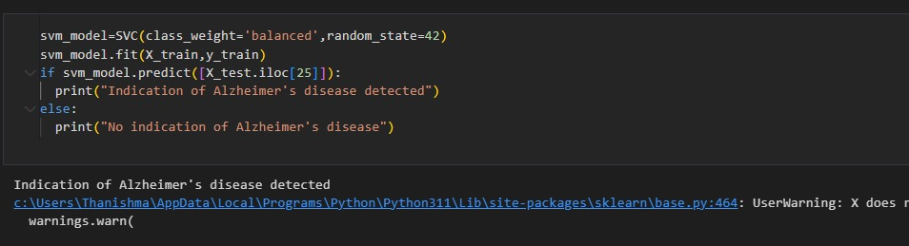
Prediction Results :
The model predicts possibility of Alzheimer’s disease based on given features of demographic and cognitive health metrics.
For this prediction, based on the input features, the model predicts no signs of Alzheimer’s, hence the individual is cognitively healthy and safe.
These results pinpoint the model’s capability for reliable insights into early detection and informed decision making

Slide 23


Large image
References: https://docs.google.com/document/d/1X-RHfXRFxaBbKhgfoEd_gVrKFLEe72a0h-9EYsIxaZM/edit?usp=sharing

Slide 24
Thank you

